Slide 1
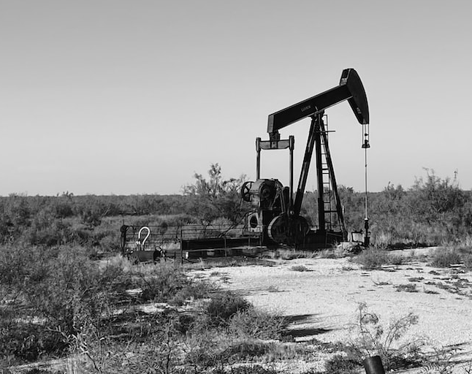
Crude Oil Price Prediction
QF 624 – Group 7 Presentation

Slide 2

Executive Summary
The following presentation offers a glimpse of a continuous learning and exploration of the application of machine learning in asset price prediction
Benchmark analyses were conducted to set the basis of the project
A preliminary exploration on various machine learning techniques were showcased, along with reflections on shortcomings
A deepdive on LSTM model is then conducted, with application of proper machine learning framework and techniques

Slide 3

Highly researched topic with limited success due to multiple factors influencing price movement, making prediction a complex task
Our objectives are to:
Study and uncover features that could be material information at providing accurate predictions on commodity prices
Apply machine learning techniques in latest studies on wide ranging features,
Building on latest studies being done on Machine Learning oil price prediction, our team will leverage on deep learning models like LSTM to train on various different datasets such as technical indicators, futures contract, company default probabilities and macroeconomic data to make predictions
Explore various model optimization and hyperparameter techniques to improve performance of price prediction model
We will compare our model against various different models as benchmark

Slide 4

Benchmark Analysis
Linear Regression, ARIMA

Slide 5
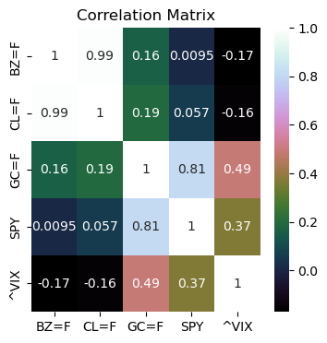
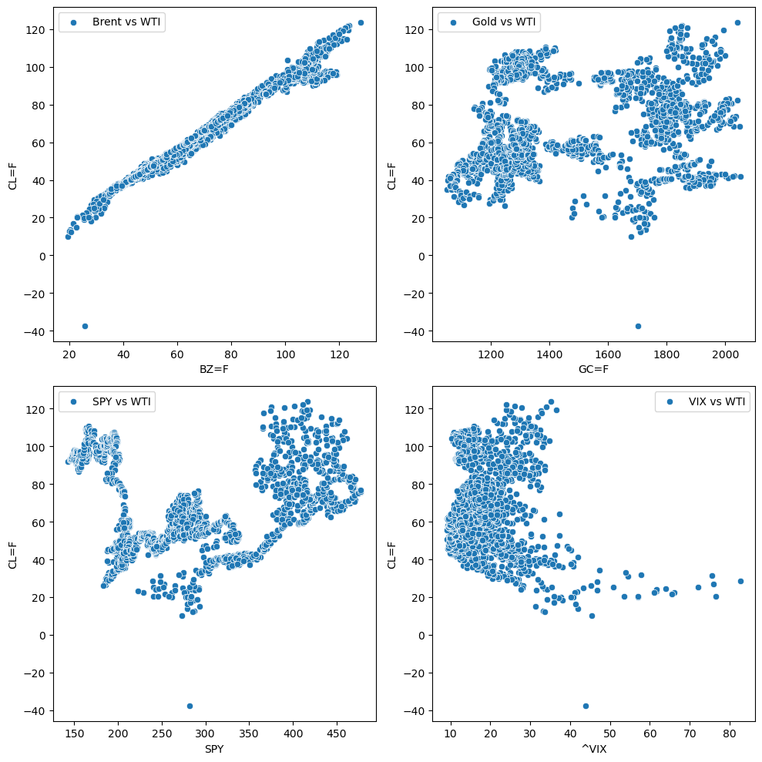
Benchmark: Linear Regression Model
Based on correlation matrix, its unsurprising that Brent (BZ=F) is highly correlated to WTI (CL=F) with a correlation of 0.99

Slide 6
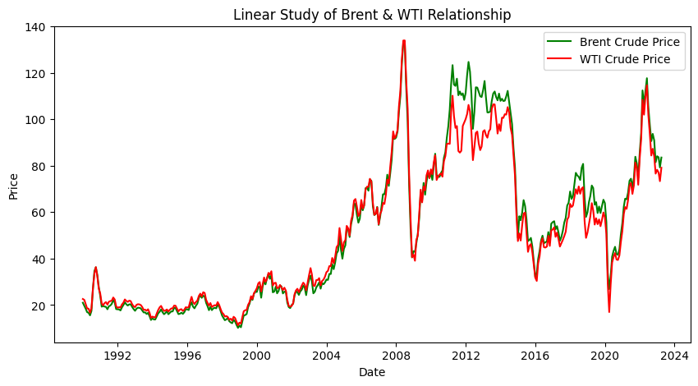
Brent versus WTI Crude Price - Historical
Studies have shown that there were numerous occurrence of structural pair breakage between Brent and WTI throughout history.¹ ²
Simple linear models may not be able to capture exogenous factors ie. macroeconomics, geopolitical events, or market fundamentals.
Although the pair is closely related, linear models may not generalize well in scenarios such as market shocks and fluctuations.
¹Buyuksahin, B., Lee, T. K., Moser, J. T., & Robe, M. A. (2013). Physical markets, paper markets and the WTI-Brent spread. The Energy Journal, 34(3).
²Ruble, I., & Powell, J. (2021). The Brent-WTI spread revisited: A novel approach. The Journal of Economic Asymmetries, 23, e00196.

Slide 7
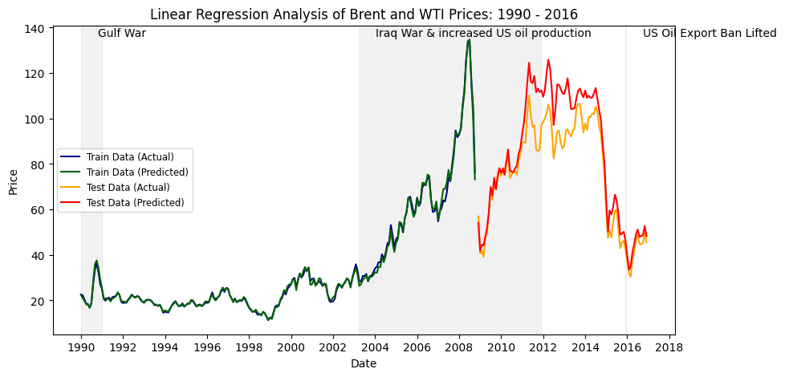
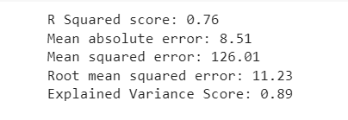
Brent versus WTI Crude Price – Linear Regression Model

Slide 8
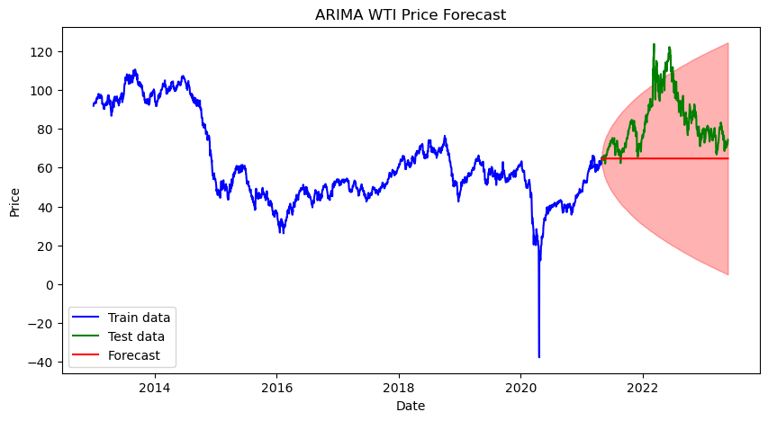
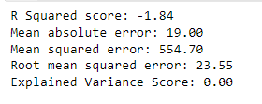
Benchmark: ARIMA Model
ARIMA(3,1,2) Model
0 explained variance and very high MSE and low R Squared
Insensitive to price fluctuations and shocks
Poor predictor for non-linear or long term forecast
As highlighted in many studies that linear models like GARCH and ARIMA struggles to effectively model market fluctuation and dynamics accurately.³ ⁴
³Siami-Namini, S., Tavakoli, N., & Namin, A. S. (2018, December). A comparison of ARIMA and LSTM in forecasting time series. In 2018 17th IEEE international conference on machine learning and applications (ICMLA) (pp. 1394-1401). IEEE.
⁴Majumder, M. M. R., & Hossain, M. I. (2019, February). Limitation of ARIMA in extremely collapsed market: A proposed method. In 2019 International Conference on Electrical, Computer and Communication Engineering (ECCE) (pp. 1-5). IEEE.

Slide 9

Preliminary Model Exploration
Fundamental data, related assets, Supplier default probability, and others

Slide 10
Features universe for preliminary exploration
Fundamental Data
Related Assets
Technical Indicators
Supply & Demand
CFTC Commitment of Trades
Weather Data
Oil Supplier Stock ETF
Default Probability of Oil Producers and Suppliers
Brent Crude Oil
Equities (DJIA, SPY, VIX)
FX, US T-Bill, Gold
SMA 10, 30,50, 100, 200 days
EMA 10, 20, 50, 99 days
RSI 7, 14, 21, 49 days

Slide 11
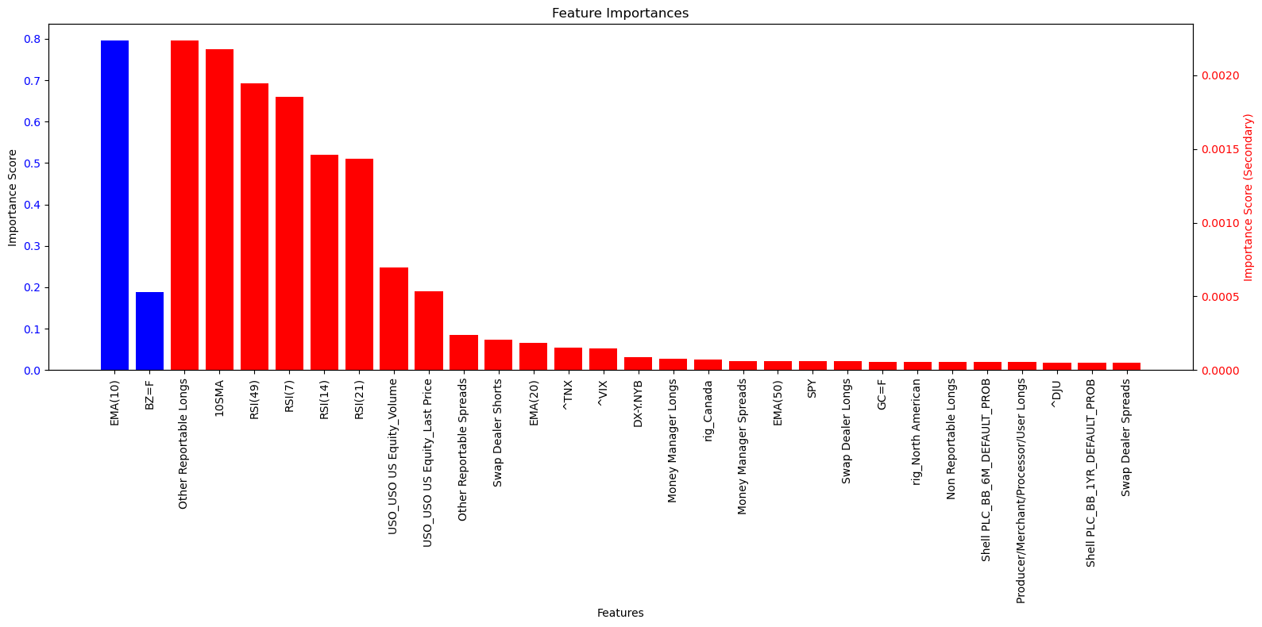
Features Selection
Steps
Create a RandomForestRegressor model
Fit the model with feature data (X) and target variable (y)
Retrieve the feature importance from the trained model
Sort the feature importance in descending order
Select the top 50 features with the highest importance
Why exclude features ranked 51st onwards?
Features importance drop falls below order of 10⁻⁵

Slide 12
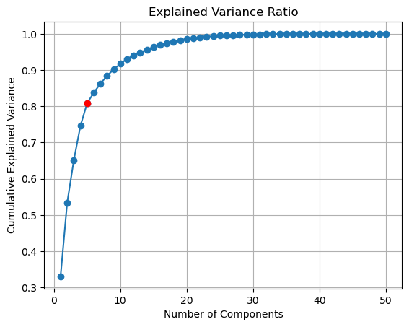
Dimensionality Reduction
As there are 50 features identified, it is important to reduce dimension to avoid overfitting. Principal Component Analysis is applied here
Steps
Standardize data
Apply PCA
Visualize Explained Variance
Determine the number of components to retain – to capture 80% of explained variance
Reapply PCA with the selected number of components

Slide 13




Models Exploration
Grid search on:
'n_estimators': [100, 200, 500],
'max_depth': [None, 5, 10],
'min_samples_split': [2, 5, 10]
Grid search on:
'n_estimators': [100, 200, 500],
'max_depth': [3, 5, 10],
'learning_rate': [0.01, 0.1, 0.2]
RandomForest Regressor
Gradient Boosting
LSTM(with hyperparameter tuning)
Grid search on:
param_grid = {'units': [32, 64, 128],
'epochs': [50, 100, 150],
'batch_size': [16, 32, 64]}
Long Short-term Memory network
Support Vector Machine
Grid Search will be covered in more depth at later part of the project

Slide 14
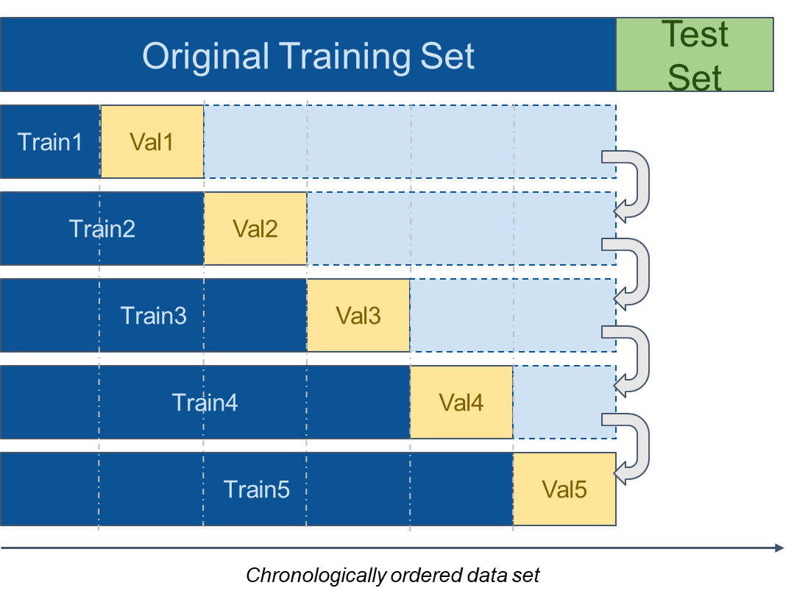
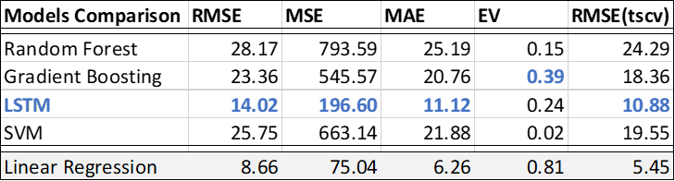
Time Series Cross-Validation
For time series, it is extremely important to preserve its chronological order to prevent future information into the training data set. This renders typical k-fold cross validation unsuitable.
Instead, a time series time series method is applied, by splitting the data sets into buckets, and at each validation round, increasing the number of buckets being trained, and having the validated bucket being the succeeding bucket.

Slide 15
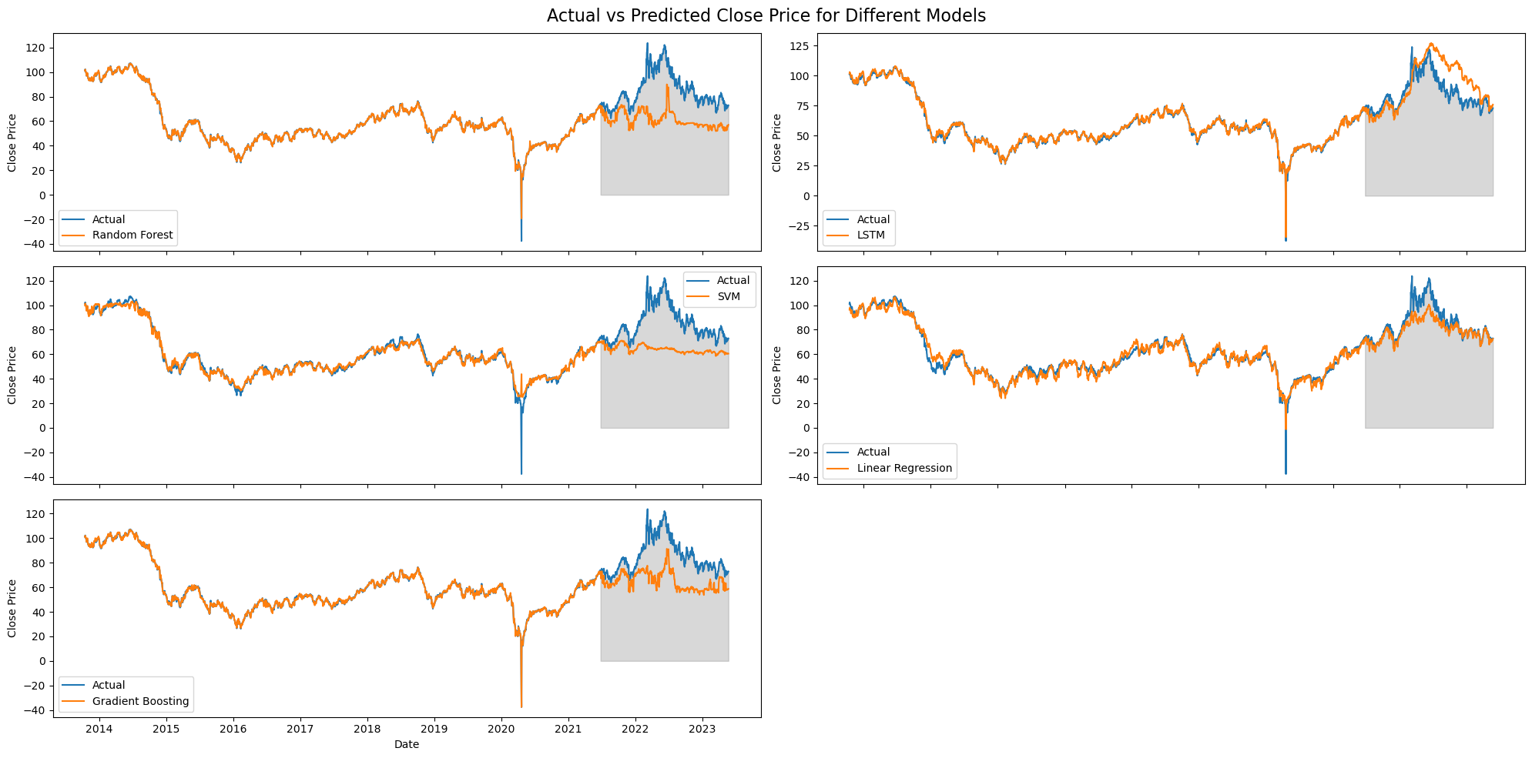
Model Evaluation

Slide 16

Reflection 1
Although the models do not show good predictive power, LSTM outperformed other ML models.
We tried to make both y and X as returns but the result still doesn’t meet the expectation.
Models may take too much noise from “fundamentals” features.
If we look back to features importance, we find that the most important ones are from technical indicators and other related assets. Those “fundamentals” features could even be neglected.
We decided to pivot:
Pick out LSTM as our targeted models
Train the model only with other assets’ price and TA indicators.

Slide 17
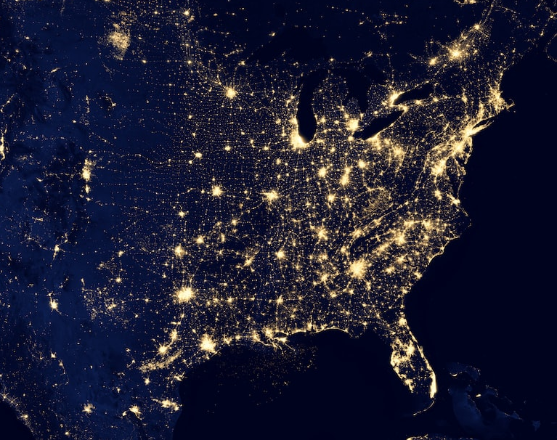
Deep-diving into LSTM Model
Cross-validation, Hyperparameter tuning, Bayesian Optimization

Slide 18
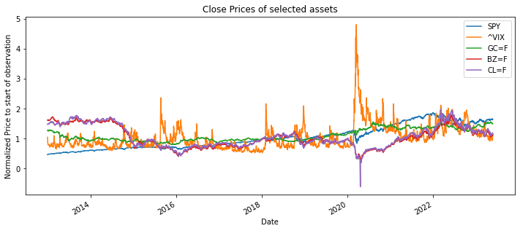
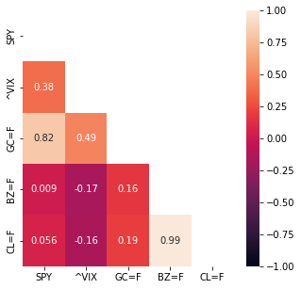
Features Selections – 2 Hypotheses (1)
Hypothesis 1 - key index and related asset prices (before and including T-1) have predictive power over the future price of crude oil (T+3)
S&P 500 index - leading indicator of the US equity markets, and a proxy to developed markets
VIX Index - volatility index based on S&P 500 options, a fear gauge of the markets
Gold - primary inflation hedging instrument
Brent Crude - highly correlated asset to WTI Crude
WTI Crude - historical price of WTI Crude may have predictive power of its future prices
Some observations
High correlation between WTI and Brent
VIX’s spikes appear to foreshadow drops in WTI prices
Low correlation between WTI and gold, and S&P 500

Slide 19
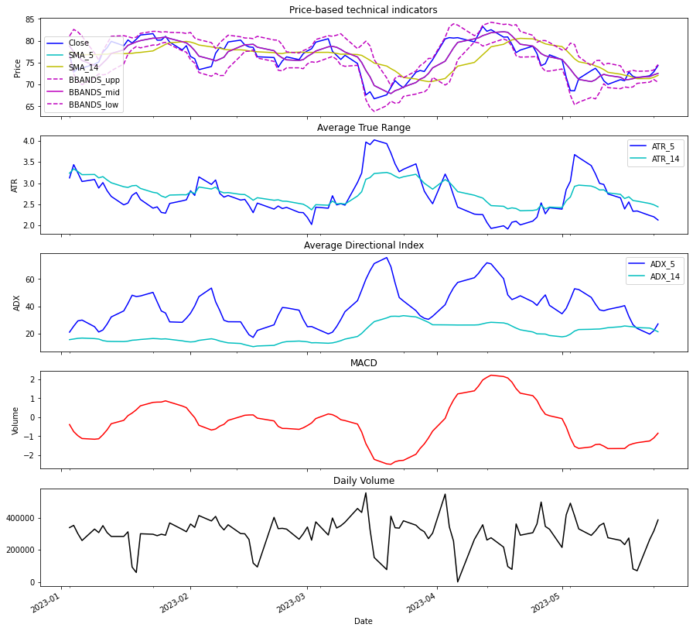
Features Selections - 2 Hypotheses (2)
Hypothesis 2 - Asset’s own technical indicators may capture crucial historical patterns and market psychology, and thus may have predictive power over future price (T+3)
Previous close prices
Previous traded volume
Simple moving average (5 days, 14 days)
Average True Range (5 days, 14 days)
Average Directional Index (5 days, 14 days)
Relative Strength Index (5 days, 14 days)
MACD
Bollinger Bands

Slide 20
Machine Learning Pipeline
Data preprocessing
Features Selection and Engineering
Split into train and test sets
Standardize data
Initialize LSTM Model
Number of layers
Number of units (neurons) per layer
Activation Functions
Optimizer
Regularizer
Cross-validation
Time Series Split – 5 folds
Fit model with batch size = 100, 50 epochs
Analysis
Compare loss curves of training and validation sets
Identify optimal epoch no.
Prediction
Run model prediction with test data
Model Optimization, Hyperparameter Tuning

Slide 21
The unoptimized LSTM architecture
Features
(1,1)
(2,1)
Flattener
(1,2)
(2,2)
Flattener
…
…
(1,127)
(2,63)
(1,128)
(2,64)
Optimizer: Adam
Learning Rate: 0.005

Slide 22
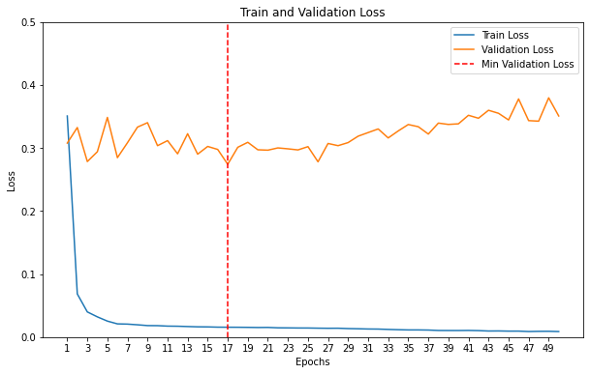
Unoptimized model: Results from cross-validation
Model Hypothesis 1 (Model H1)
Cross-validation MSE and optimal number of epochs
Optimal no. of epochs: 17
Average validation MSE at optimal: 0.2741

Slide 23
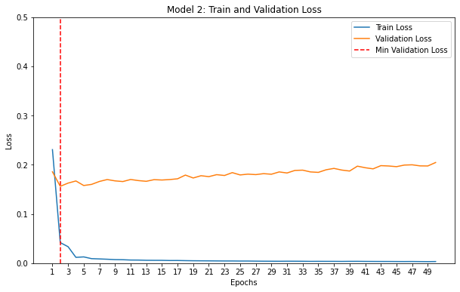
Unoptimized model: Results from cross-validation
Model H2
Cross-validation MSE and optimal number of epochs
Optimal no. of epochs: 2
Average validation MSE at optimal: 0.1562
Unlike the previous attempt, a much lower epoch run is required.

Slide 24
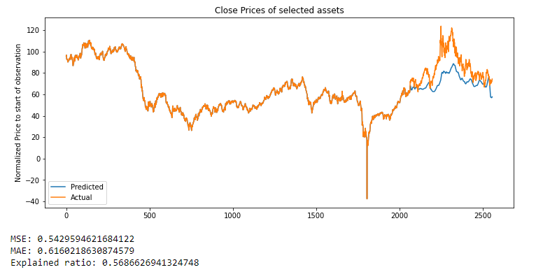
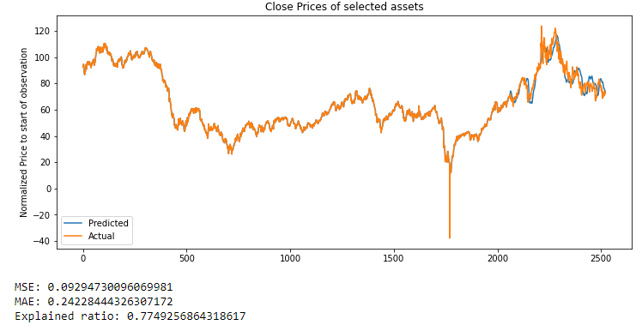
Comparing unoptimized model test results
The tests conclude with better performance using WTI Crude oil price technical indicators.
Technical indicators contain more useful information on the WTI Crude oil price development in the near-term future.

Slide 25

Reflection
Whilst the unoptimized models achieved decent results, it is crucial to improve the model in order to increase its robustness. Plausible areas of improvement are
Features engineering - explore other features, or combine both sets of features
Regularization - apply penalty to model for overfitting
Optimizing hyperparameters - number of neurons per layer, optimizers used
The next section explores model optimization and hyperparameters tuning.

Slide 26




Importance of Hyperparameter Tuning
Hyperparameter tuning is crucial for optimizing LSTM models in crude oil price prediction. Proper tuning improves accuracy, model generalization, and efficient resource utilization.
Techniques used for Hyperparameter Tuning
Grid search: Exhaustively searches predefined hyperparameter combinations but can be computationally expensive.
Keras tuner: Alternative brute force optimisation from the Keras library
Bayesian optimization: Uses probabilistic models to guide the search process, balancing exploration and exploitation for efficient tuning.

Slide 27
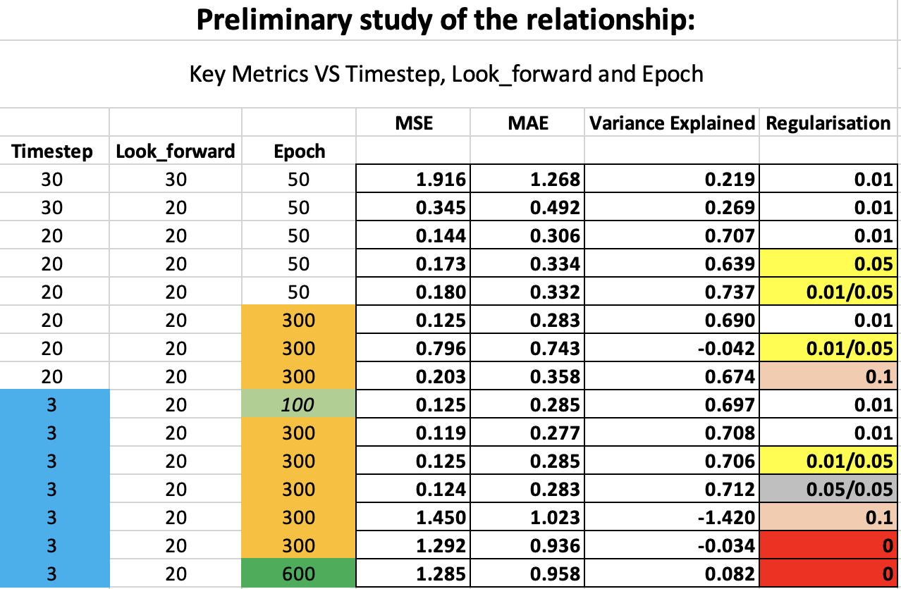

Slide 28

Learnt intuitions
Higher epoch setting gives convergence of training loss and better key metrics, ceterus paribus.
Regularization is tricky and it is difficult to arrive at the optimal value. Best to do cv regularisation
Timestep provides granularity that is important in price prediction. If we raise the timestep, the prediction curve will be "smooth", signifying high bias. Requires L1 regularization

Slide 29

Grid Search
A brute-force approach that performs “trial and error” on all possible combinations of parameters.
Provides a comprehensive exploration of the hyperparameter space
Easy to implement with sklearn library, import sklearn.model_selection import GridSearchCV
Hyperparameters optimized
Optimizers [Adam, Sgd]
Learning rate [0.005, 0.01, 0.03, 0.1]

Slide 30
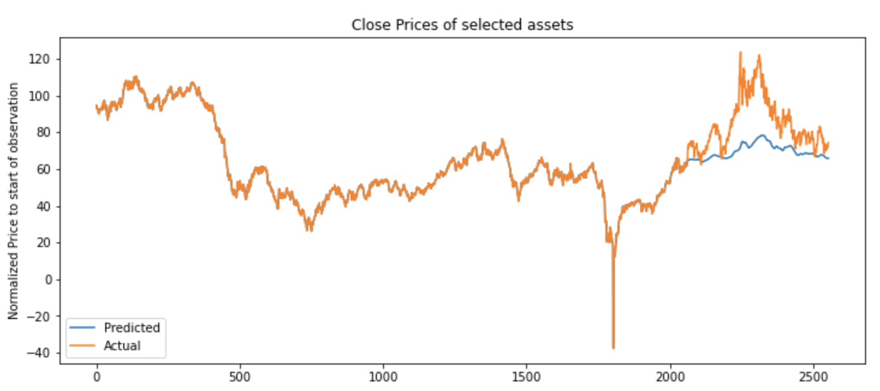
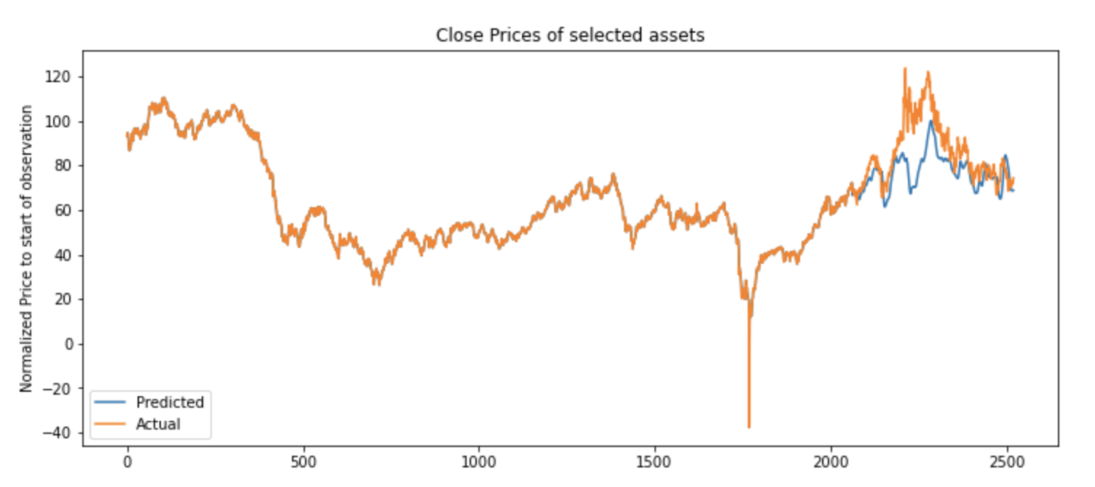
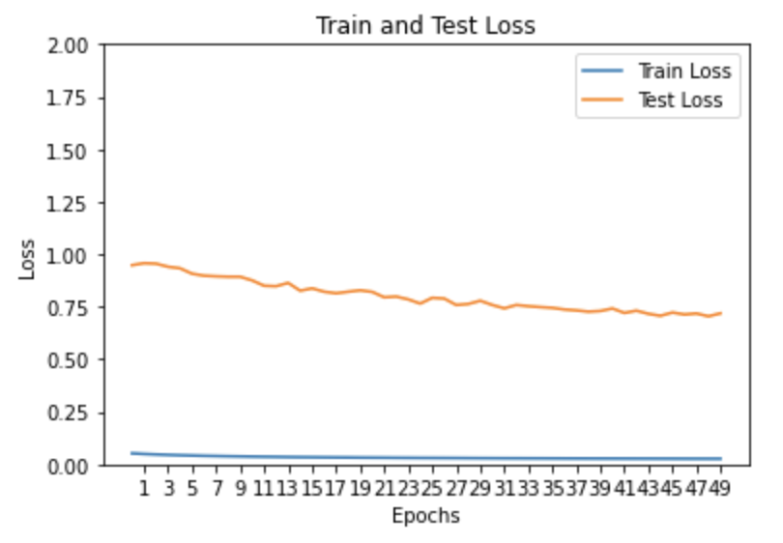
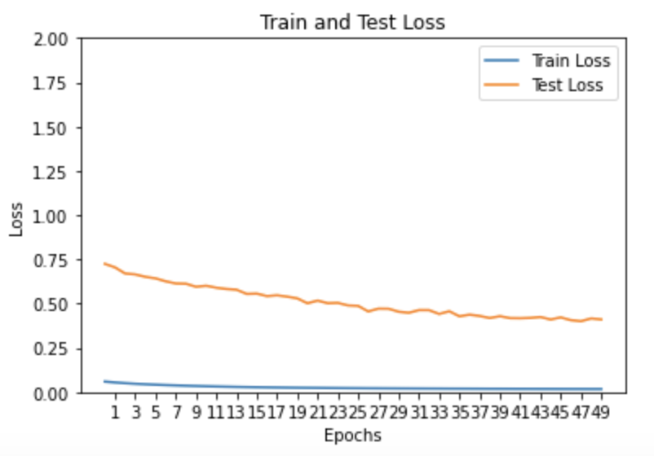
Results after grid search (no regularization)
Model 1
Model 2

Slide 31

Random Search
A time-efficient alternative to Grid-Search
Iterates through hyperparameters in less time using random combinations
Speeds up the search but it doesn’t give absolute optimal results

Slide 32
List of hyperparameters to tune
Number of neurons (units) in each LSTM layer (choice: any multiple 32 units from 32 – 192 units)
Number of units in the first dense layer (choice: any multiple 5 units from 5 – 25 units)
Learning rate (choice: between order of 10⁻⁴ and 10⁻²)
Optimizer (choice: between Adam and Stochastic Gradient Descent)
Activation function (choice: Hypotenuse Tangent (tanh) or Rectified Linear Unit (ReLU)
Regularization (choice: between L1 and L2, with value of 0.001, 0.01, 0.1)
The Random Search tuning is achieved using Keras-Tuner

Slide 33
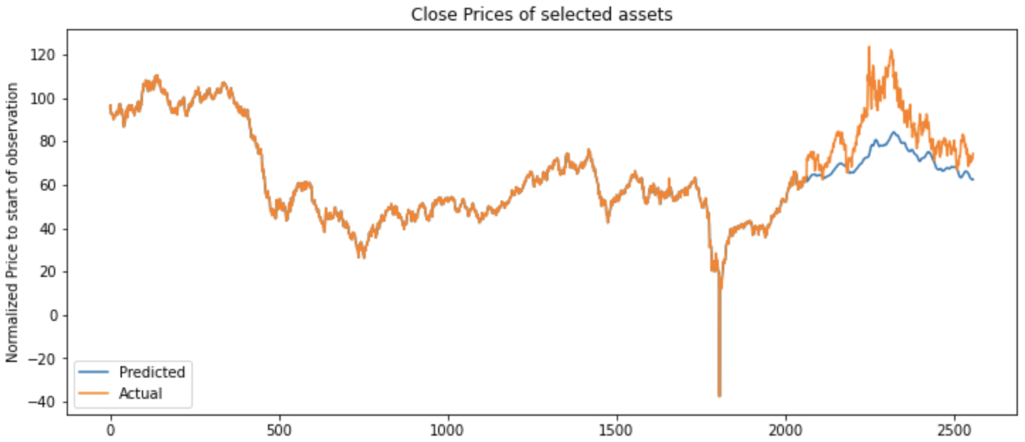
Results of Keras-Tuner for Model H1
Hyperparameters | Optimized hyperparameters
LSTM layer # units | 128 (layer 1) 32 (layer 2)
Dense layers # units | 25
Learning rate | 0.390
Optimizer | SGD
Activation function | Layer 1: Tanh Layer 2: ReLU
Regularization | None
MSE: 0.575, MAE: 0.642 Explained Ratio: 0.581

Slide 34
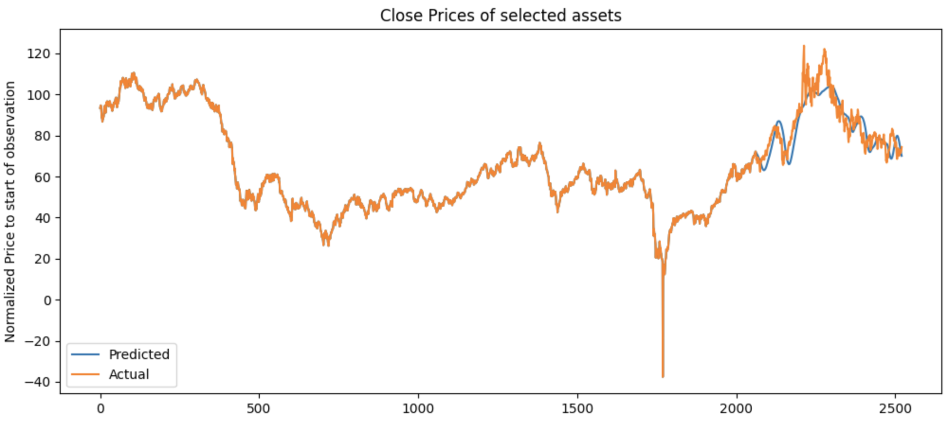
Results of Keras-Tuner for Model H2
Hyperparameters | Optimized hyperparameters
LSTM layer # units | 64 (layer 1) 32 (layer 2)
Dense layers # units | 5
Learning rate | 0.000572
Optimizer | SGD
Activation function | Layer 1: ReLU Layer 2: Tanh
Regularization | L1 @ 0.1
MSE:0.115, MAE: 0.271 Explained Ratio: 0.732

Slide 35


Evaluation of Keras-Tuner
Issues
Random selection of hyperparameters does solve the issue of computation time needed. However, it is doesn’t guarantee absolute optimal hyperparameters.
Potential Solution
Instead of all combinations being random, it chooses first few randomly, and perform the further iterations conditionally based on the performance on previous parameters.

Slide 36

Bayesian Optimization
Hyperparameters Optimized
1. # of lstm layer 1 : (32,512)
2. # of lstm layer 2: (32,512)
3. # of dense layer 1: (16, 256)
4. Batch size: (100,200)
5. Learning rate: 0.01 to 0.005
Notes:
Number of hidden layers and the number of LSTM units in each layer are the 2 critical hyperparameters that determine the model capacity to learn complex pattern in the data
Increasing the number of hidden layers or the number of LSTM units can help the model to capture more intricate patterns, but may also lead to overfitting
Decreasing the number of hidden layers or the number of LSTM units may result in underfitting, where the model cannot capture the full complexity of the data
Learning rate and batch size: control the rate at which the model updates its parameters during training
A high learning rate may result in the odel overshooting the optimal solution, while slow learning rate may lead to slow convergence
A small batch size may result in noisy gradients and slower convergence, while a large batch size may lead to overfitting
Bayesian optimization is a more advanced method for hyperparameter tuning that uses a probabilistic model to select the next set of hyperparameters to evaluate.
The probabilistic model estimates the performance of the model for each combination of hyperparameters and selects the next set of hyperparameters to evaluate based on the model’s estimated performance.
This method is particularly useful when the hyperparameter space is large and evaluation all combinations is not feasible
Expected Improvement: The expected improvement acquisition function aims to find the next point to sample in order to maximize the improvement over the current best value. It considers the probability distribution of the objective function and quantifies the expected improvement in performance if a certain point is sampled. This function balances exploration (sampling points with high uncertainty) and exploitation (sampling points that are likely to yield better performance).
qExpected Improvement: The qExpected Improvement acquisition function extends the expected improvement by considering the joint improvement of multiple points simultaneously. It allows for selecting multiple points to sample at each iteration, which can be more efficient in high-dimensional optimization problems or when parallel evaluations are possible. It trades off between exploration and exploitation while considering the improvement of multiple points collectively.
Upper Confidence Bound: The Upper Confidence Bound (UCB) acquisition function is based on the principle of optimism in the face of uncertainty. It balances exploration and exploitation by selecting points with both high potential and high uncertainty. UCB uses a trade-off parameter to control the balance between exploring new regions and exploiting the regions with the highest expected rewards. It provides a systematic way to explore the search space and gradually focus on promising areas.
qKnowledge Gradient: The qKnowledge Gradient acquisition function aims to select points that maximize the expected information gain or knowledge gain. It considers the value of obtaining additional information by selecting a certain point for evaluation. The qKnowledge Gradient allows for selecting multiple points simultaneously, similar to qExpected Improvement. It takes into account both the uncertainty in the model predictions and the potential improvement in performance, promoting a balance between exploration and exploitation.

Slide 37

Acquisition Functions
Acquisition functions guide the selection of hyperparameters to evaluate in Bayesian optimization.
They balance exploration and exploitation in the search space.
In this implementation, the following 4 acquisition functions are used.
Expected Improvement
aims to find the next point to sample to maximize improvement over the current best value
qExpected Improvement
extends EI by considering the joint improvement of multiple points simultaneously, and allows selecting multiple points at once, making it suitable for high dimensional optimization problem
Upper Confidence Bound
works by using the predetermined trade off parameter to control the balance between exploration and exploitation
qKnowledge Gradient
aims to select points that maximize the expected information gain

Slide 38
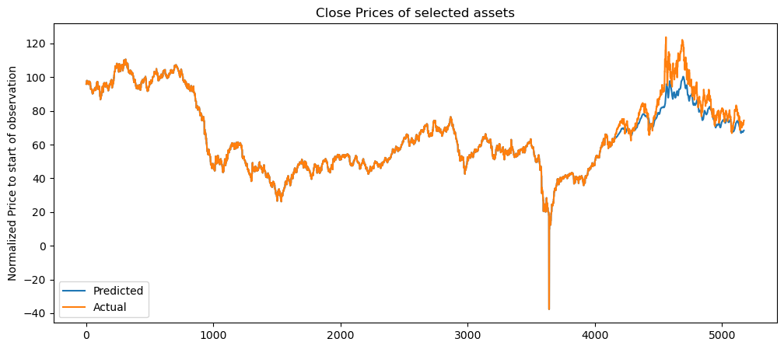

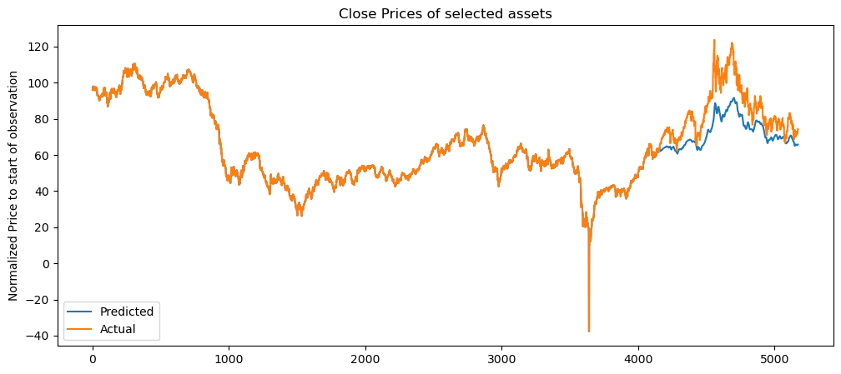
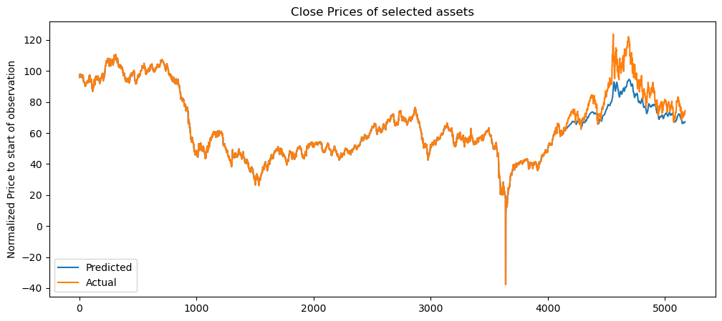
Model H1: Comparison across different acquisition functions
EI
qEI
MSE: 0.17
MAE: 0.31
Explained Ratio: 0.8
Epoch: 2
MSE: 0.13
MAE: 0.27
Explained Ratio: 0.81
Epoch: 10
UCB
qKG
MSE: 0.40
MAE: 0.55
Explained Ratio: 0.75
Epoch: 9
MSE: 0.26
MAE : 0.42
Explained Ratio: 0.78
Epoch: 8

Slide 39
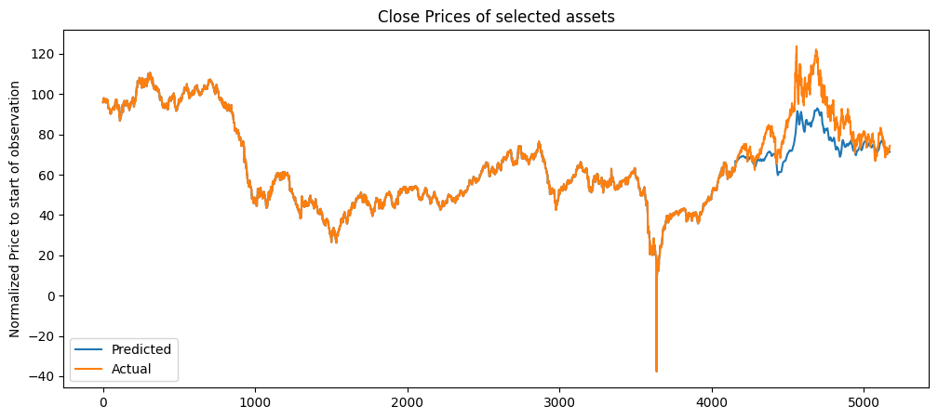
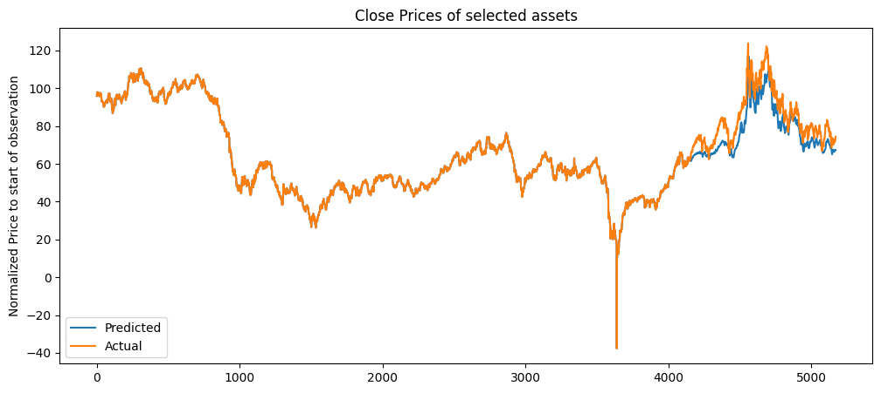

Model H2: Comparison across different acquisition functions
EI
qEI
MSE: 0.33
MAE: 0.46
Explained Ratio: 0.67
Epoch: 10
MSE: 0.15
MAE: 0.42
Explained Ratio: 0.83
Epoch: 10
UCB
qKG
MSE: 0.38
MAE: 0.52
Explained Ratio: 0.71
Epoch: 14
MSE: 0.24
MAE: 0.34
Explained Ratio: 0.88
Epoch: 42

Slide 40

Comparing test results
In both models, qEI acquisition function results in superior predictive accuracy of the LSTM model
This shows that qEI’s method of considering the joint improvement of multiple points simultaneously and allowing to select multiple points at once leads to a more efficient exploration for this model

Slide 41
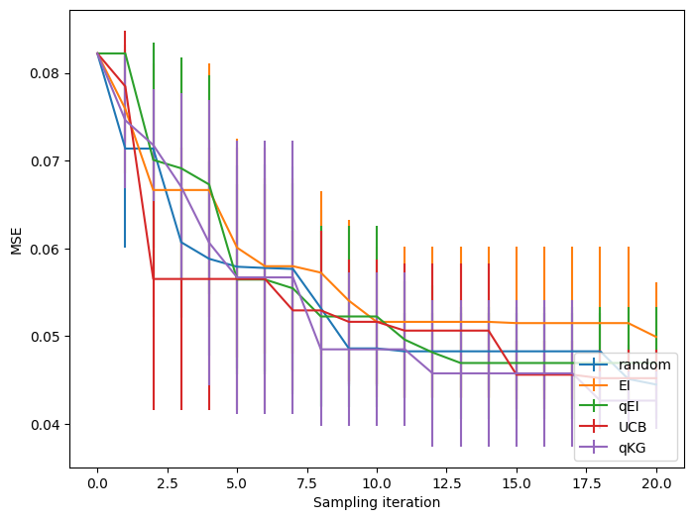
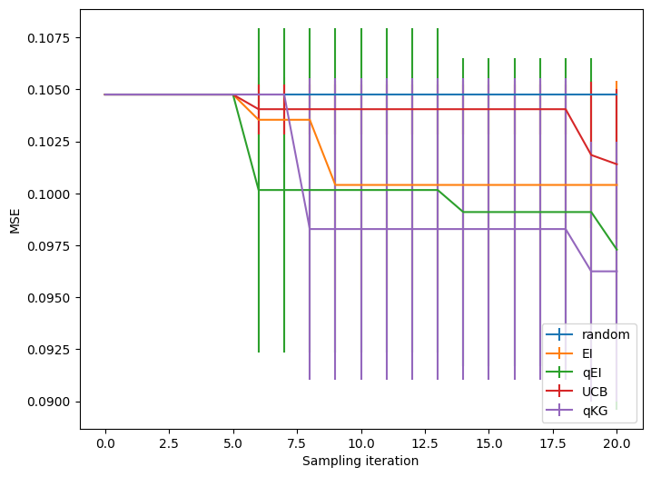
Multiple Bayesian Optimizations
Due to the stochastic nature of the process, Bayesian Optimization across multiple tests yields different results

Slide 42
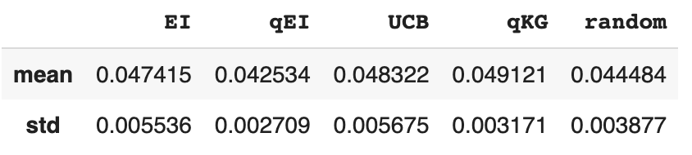
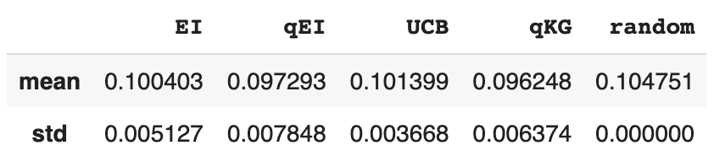
Multiple Bayesian Optimizations
Model H1
The stochasticity in the process arises from multiple sources:
Initial random sampling
Surrogate model estimation
Acquisition function optimization
Randomness in the objective function
Model H2
Notes:
The stochasticity in the process arises from multiple sources:
Initial random sampling: Bayesian optimization typically starts with an initial random set of hyperparameters. Since the initial set is chosen randomly, it can lead to different starting points and consequently different optimization trajectories.
Surrogate model estimation: Bayesian optimization utilizes a surrogate model, often a Gaussian process, to model the underlying objective function. The surrogate model is updated as new evaluations are made, incorporating the observed data. However, the model estimation itself can have some randomness due to the inherent noise in the data.
Acquisition function optimization: The acquisition function guides the selection of the next set of hyperparameters to evaluate. The optimization of the acquisition function can involve numerical optimization techniques, which may have multiple local optima. Different starting points or optimization strategies can lead to different solutions.
Randomness in the objective function: In some cases, the objective function itself may have inherent randomness or noise. This can be seen in scenarios where the objective function involves random simulations, noisy measurements, or other stochastic processes.
Due to these sources of stochasticity, it is common to run Bayesian optimization multiple times to obtain more reliable results. By averaging the outcomes or considering statistical measures of performance, such as mean and standard deviation, we can gain a better understanding of the algorithm's behavior and the variability in its results.

Slide 43
Results Comparison
Model H1
 | Unoptimized | Grid Search | Keras Tuner | Bayesian
MSE | 0.54 | 0.71 | 0.58 | 0.13
MAE | 0.62 | 0.70 | 0.64 | 0.27
Explained Ratio | 0.57 | 0.41 | 0.58 | 0.81
Overall, Bayesian optimization results in the highest explained ratio. This indicates that the model is best at capturing the underlying patterns and trends
Bayesian model has the overall best performance in all 3 aspects for Model H1 but lower MSE for Model H2
This might be due to:
Overfitting
Trade of between bias and variance
Randomness in the optimization process
Model H2
 | Unoptimized | Grid Search | Keras Tuner | Bayesian
MSE | 0.09 | 0.41 | 0.12 | 0.15
MAE | 0.24 | 0.46 | 0.27 | 0.42
Explained Ratio | 0.77 | 0.42 | 0.73 | 0.83
Notes:
The explained variance ratio (or explained ratio) and mean squared error (MSE) are two different evaluation metrics that capture different aspects of model performance.
Explained Variance Ratio: The explained variance ratio measures the proportion of the variance in the dependent variable (e.g., crude oil price) that can be explained by the independent variables (e.g., features used in the model). A higher explained variance ratio indicates that the model is better at capturing the underlying patterns and trends in the data. It indicates how well the model fits the data and how much of the variability in the dependent variable can be attributed to the model's predictions. Therefore, a higher explained variance ratio suggests a better predictive performance in terms of capturing the overall trend in the data.
Mean Squared Error: The mean squared error measures the average squared difference between the predicted values and the actual values. It quantifies the magnitude of prediction errors. A lower MSE indicates that the model's predictions are closer to the actual values on average. It assesses the accuracy and precision of the model's predictions. A lower MSE suggests a better predictive performance in terms of minimizing the prediction errors.
Now, regarding your specific case where the Bayesian optimized model has a higher explained ratio but a lower MSE compared to the unoptimized model, it could be due to the following reasons:
Overfitting: The Bayesian optimized model might be overfitting the data, capturing the underlying patterns and trends more accurately. As a result, it achieves a higher explained variance ratio. However, this increased complexity could lead to higher variance and a lower ability to generalize, resulting in a higher MSE.
Trade-off between bias and variance: The unoptimized model might have a simpler structure or fewer hyperparameters, leading to a higher bias but potentially lower variance. This could result in a lower explained variance ratio but a lower MSE. The Bayesian optimization process might have introduced more flexibility or complexity, reducing the bias but potentially increasing the variance, which can lead to a higher explained ratio but a higher MSE.
Randomness in the optimization process: The Bayesian optimization process involves some degree of randomness due to the selection of hyperparameters and the inherent stochasticity of the optimization algorithm. The specific set of hyperparameters selected through the optimization process can influence the model's performance. It is possible that in this particular run, the optimized model achieved a higher explained variance ratio but a higher MSE.
It's important to note that the explained variance ratio and MSE are not directly comparable metrics, as they assess different aspects of model performance. Therefore, it's essential to consider both metrics and the specific goals of your modeling task to determine which model is more suitable for your needs.

Slide 44
Optimizers Comparison
Grid Search |  | Keras Tuner (Random Search) |  | Bayesian
Pros | Cons | Pros | Cons | Pros | Cons
Brute-force approach that ensures no combination is missed, providing a comprehensive exploration of the hyperparameter space | Computationally expensive for large grids or complex model (trial and error) | Efficient as it performs optimization through “Random Sampling” | Effectiveness declines in high-dimensional search space | Uses probabilistic model to guide the search process, hence leading to faster convergence | Might not reached to the true minimum value as it uses probabilistic approach and not an exhaustive search approach
Ease of implementation | Limited flexibility due to discrete optimisation that doesn’t interpolate between any 2 parameter values | Customisable Search Space (discrete/continous) | Potential incompatibility with PyTorch & Tensorflow | Able to find optimal hyperparameter configurations especially in high dimensional search spaces | Complex model, requiring the definition and tuning of additional parameters such as choice of acquisition function
Some degree of automation | Requires domain expertise on the initial guess |  |  |  | Required domain expertise to determine the initial range
 | Limited exploration on parameter interaction.
Notes:
grid search is simple to implement but computationally expensive and lacks optimization capabilities, while Bayesian optimization is more efficient and performs better but requires more complex setup and can be sensitive to initial conditions. The choice between the two depends on the resources available, the complexity of the hyperparameter space, and the desired tradeoff between simplicity and performance.
Grid Search:
Pros:
Simplicity: Grid search is straightforward to implement and understand. It involves defining a grid of hyperparameter values and exhaustively searching all possible combinations.
Exhaustiveness: Grid search explores all combinations within the defined grid, ensuring a comprehensive search of the hyperparameter space.
Reproducibility: Grid search is deterministic, meaning that the same set of hyperparameter values will always produce the same results.
Cons:
Computationally Expensive: Grid search can be computationally expensive, especially when dealing with a large number of hyperparameters or a wide range of values. It requires training and evaluating the model for each combination in the grid, resulting in an extensive search space.
Lack of Optimization: Grid search does not take into account the performance of previous iterations. It treats each combination independently, potentially leading to suboptimal results.
Bayesian Optimization:
Pros:
Efficiency: Bayesian optimization uses probabilistic models to guide the search process. By modeling the objective function, it can make informed decisions on which hyperparameters to explore next, leading to faster convergence.
Exploration-Exploitation Tradeoff: Bayesian optimization balances the tradeoff between exploration and exploitation. It initially explores the hyperparameter space to gather information and gradually focuses on promising regions, improving the chances of finding the global optimum.
Better Performance: Bayesian optimization tends to outperform grid search in terms of finding optimal hyperparameter configurations, especially in high-dimensional search spaces.
Cons:
Complexity: Bayesian optimization is more complex than grid search, requiring the definition and tuning of additional parameters such as the choice of the acquisition function or the selection of the surrogate model.
Sensitivity to Initial Conditions: The performance of Bayesian optimization can be sensitive to the initial set of hyperparameter configurations used to build the probabilistic model. Choosing a poor initial set can lead to suboptimal results.

Slide 45

Conclusion
Explorations of multiple machine learning techniques
With limited time and resources, Bayesian Optimization has scored highest in the defined key metrics.
After optimizing with Bayesian optimization, both hypothesis demonstrate decent accuracy performance. This finding suggests that both strategies have their own merits and can be used in conjunction
More could be done to reduce ‘noise’ by introducing more features into the dataset

Slide 46


Slide 47
Appendix

Slide 48
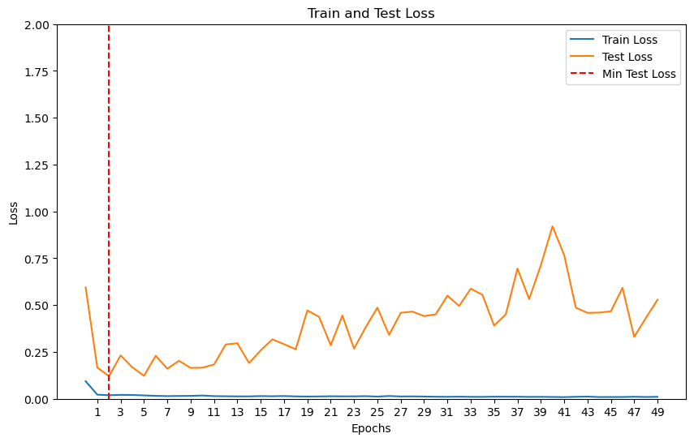
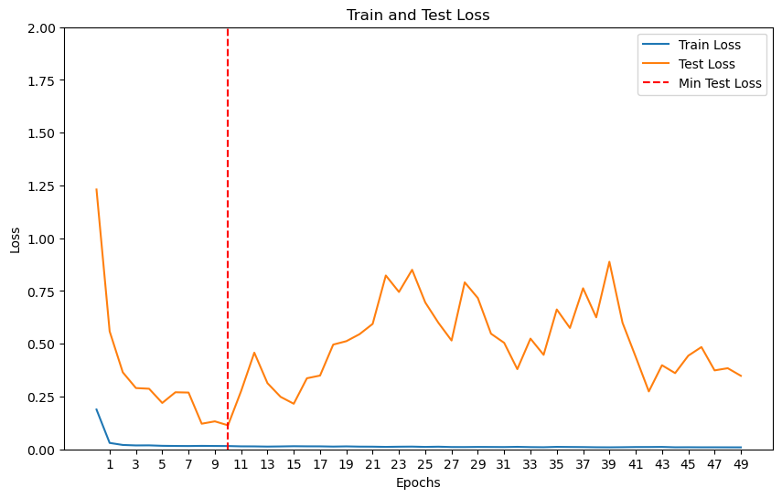
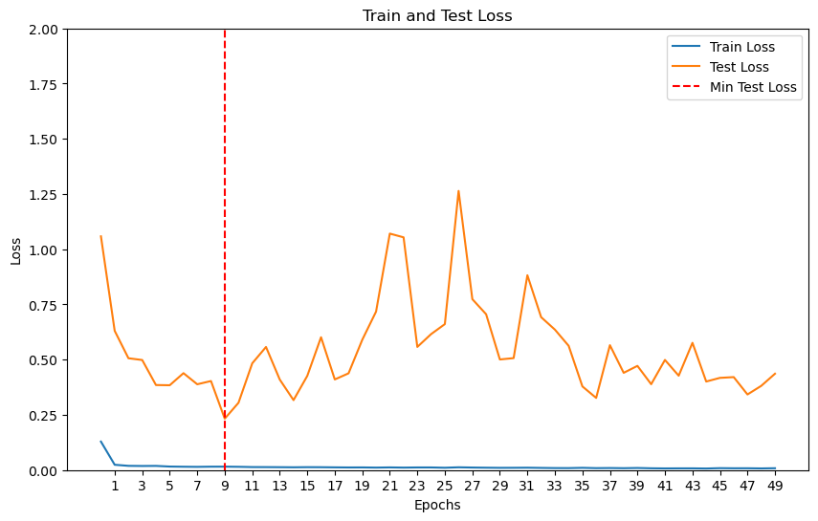
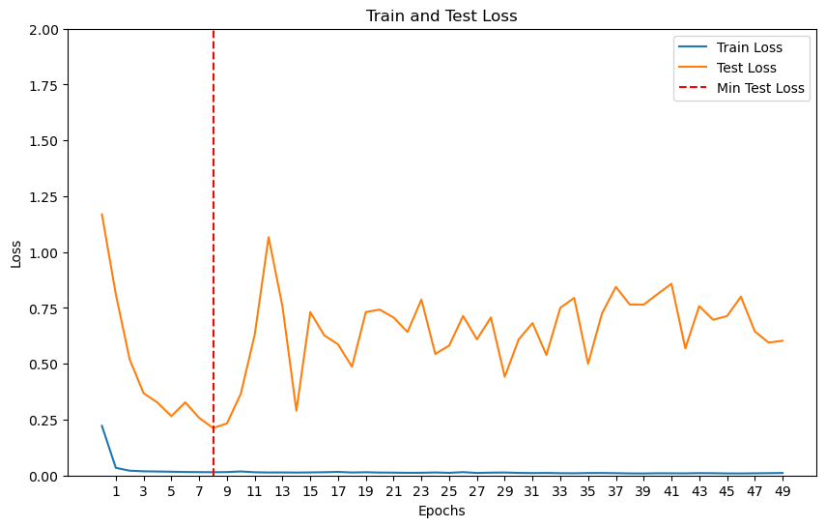
Hypothesis 1 Loss Function
EI
qEI
UCB
qKG

Slide 49
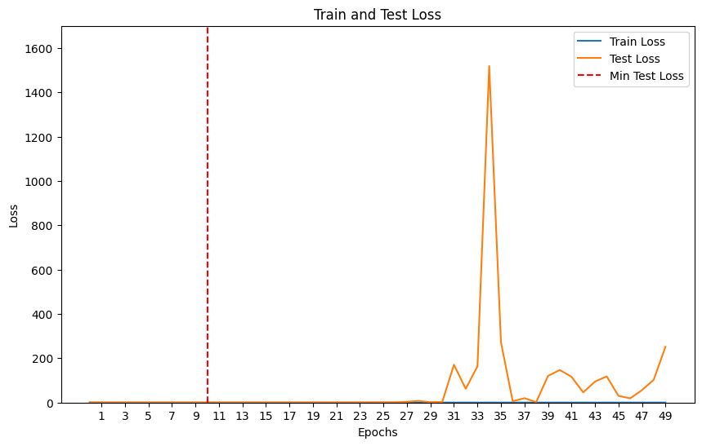
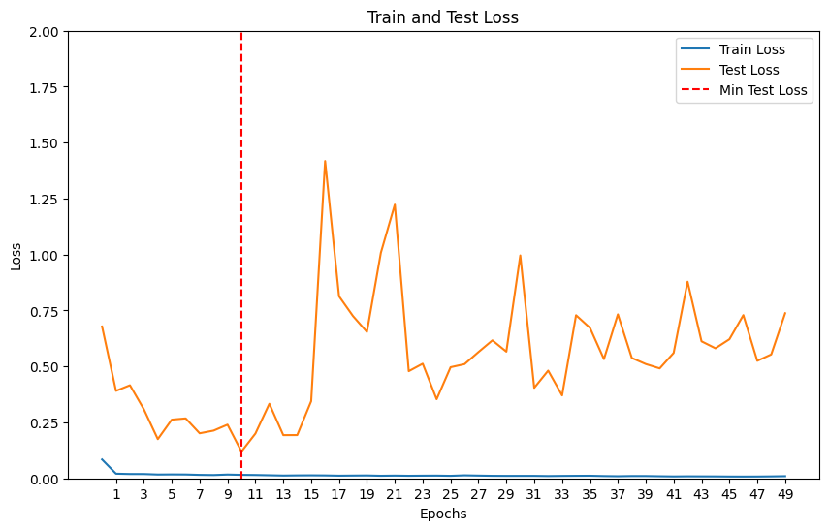
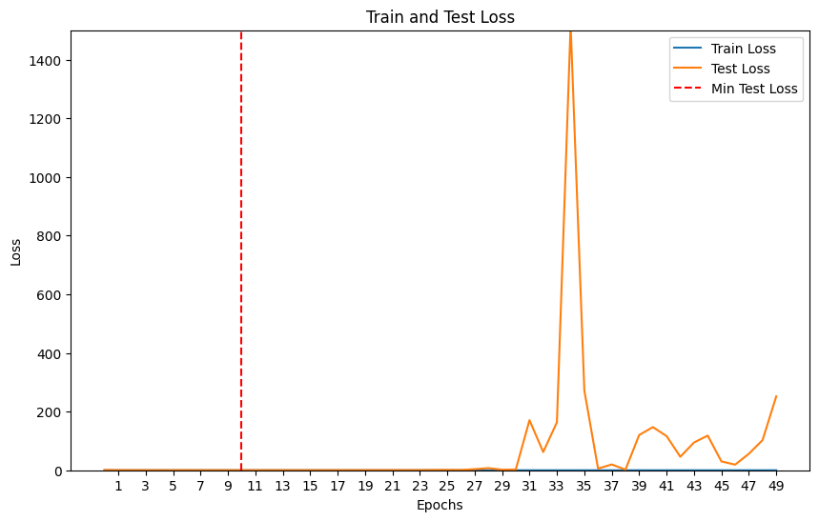
Hypothesis 2 Loss Function
EI
qEI
UCB
qKG

Slide 50
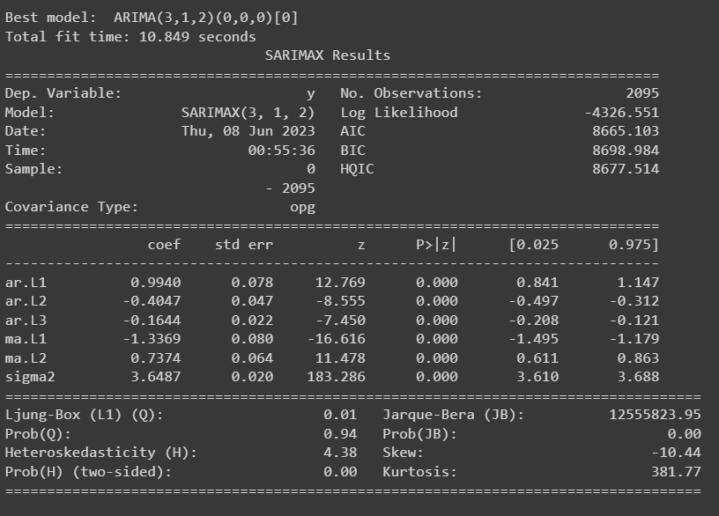
ARIMA
We imported package from pmdarima and ran auto.arima with the following results

Slide 51
Let me summarize the parameters below:
We are optimizing the MSE value by tweaking the hyperparameters below:
1. # of lstm layer 1 : (32,512)
2. # of lstm layer 2: (32,512) → i was thinking to separate layer 1 and layer 2 so that they can have diff number of units
3. # of dense layer 1: (16, 256)
4. Batch size: (100,200) → to add to tensor
5. Learning rate: 0.01 to 0.005 → to add to tensor
6. Optimizer: Adam, SGD → to add to tensor
Fixed Parameters:
1. Loss function: Mean Squared Error
2. # of dense layer 2: cannot be optimized cos have to be 1 layer
3. Epoch: set a fixed number: 50→ i think epoch dont need to be optimized. With the result, we can plot the loss and MSE with each epoch and see which epoch is the best
4. setting the activation function of 2nd LSTM layer to be ReLu
5. Look forward as 60
6. Add a loss function chart

